Slide 1

WEST NILE EPIDEMIC IN CHICAGO
Data analysis from Windy City Saints, INC.
Omar Carr – Public Relations/Data Analyst
Dr. Richard Mason – Data Scientist
Dr. Susan Mensah – Data Scientist
Dr. Jake Peavy – Data Scientist (CEO & Founder)

Slide 2
WEST NILE VIRUS – WHAT DO WE KNOW
In Illinois, West Nile was first identified in September 2001 when laboratory tests confirmed its presence in two dead crows found in the Chicago area. The following year, the state's first human cases and deaths from West Nile disease were recorded and all but two of the state's 102 counties eventually reported a positive human, bird, mosquito or horse. By the end of 2002, Illinois had counted more human cases (884) and deaths (64) than any other state in the United States.
No symptoms in most people
8 out of 10 infected do not develop any symptoms
1 in 5 will develop a fever with other symptoms
headache, body aches, joint pains, vomiting, diarrhea, or rash
Most with this type of West Nile recover completely, but fatigue and weakness can last for months
1 in 150 can develop encephalitis (brain inflammation) or meningitis.
Symptoms include high fever, headaches, neck stiffness, stupor, disorientation, coma, tremors, convulsions, muscle weakness, vision loss, numbness and paralysis.
People over 60 are at greater risk as well as those with certain medical conditions (cancer, diabetes, hypertension, kidney disease, people receiving organ transplants)
1 in 10 who develop severe illness will die
No vaccine or specific antiviral treatments are available

Slide 3
WEST NILE PREVENTION – WHAT HAS BEEN DONE
Currently, the Chicago Department of Public Health have been implementing a citywide mosquito surveillance program. The target has been adult mosquitos
In 2005, Chicago started spraying Anvil (or a ”cocktail containing” Anvil) at a rate of 0.62 fluid ounces per acre, but there were some bad effects among human and even fish and bees.
In 2010, the pesticide Zenivex was being applied at 0.87 fluid ounces per acre
Since 2013, the Zenivex application was raised to an application of 1.50 fluid ounces per acre (1 gallon = 128 fluid ounces)
The cost of Zenivex is currently $0.67 per acre (advertised in 2015)
A 30 gallon drum of Zenivex E20 costs $8,994.00 / A case of 2 * 2.5 gallon jugs costs $1,509.50(Adapco)
The City of Chicago is 149849.6 acres total.

Slide 4
DATA USED FOR OUR FINDINGS
95 weeks of data, ranging from May 29, 2007 to September 26, 2013
136 total traps, 14 of those were satellite traps
Satellite traps are located 6 blocks from the major traps
135039 mosquitos were caught
14519 of those mosquitos were found with West Nile present

Slide 5
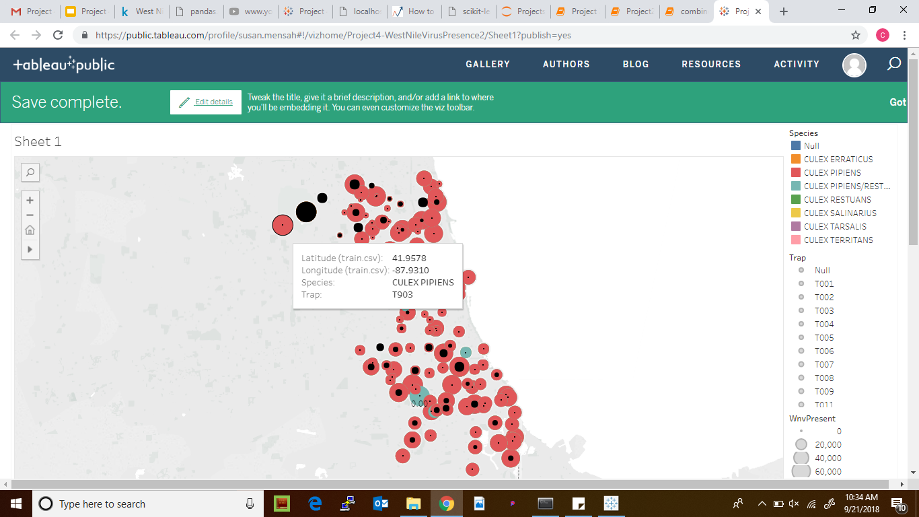
Most Prevalent Specie of West Nile Virus

Slide 6
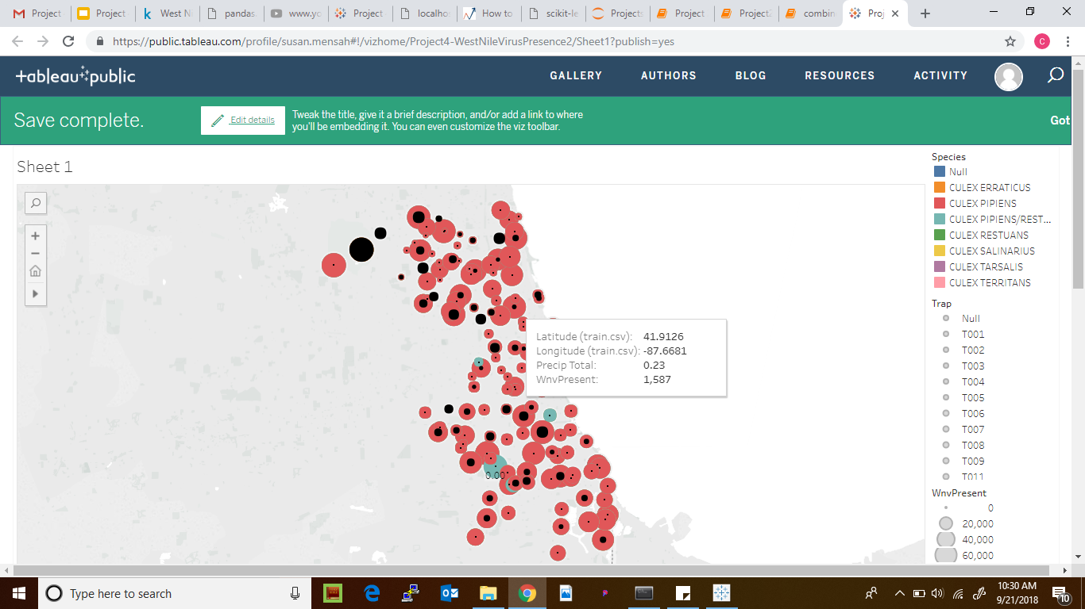

Effect of precipitation

Slide 7
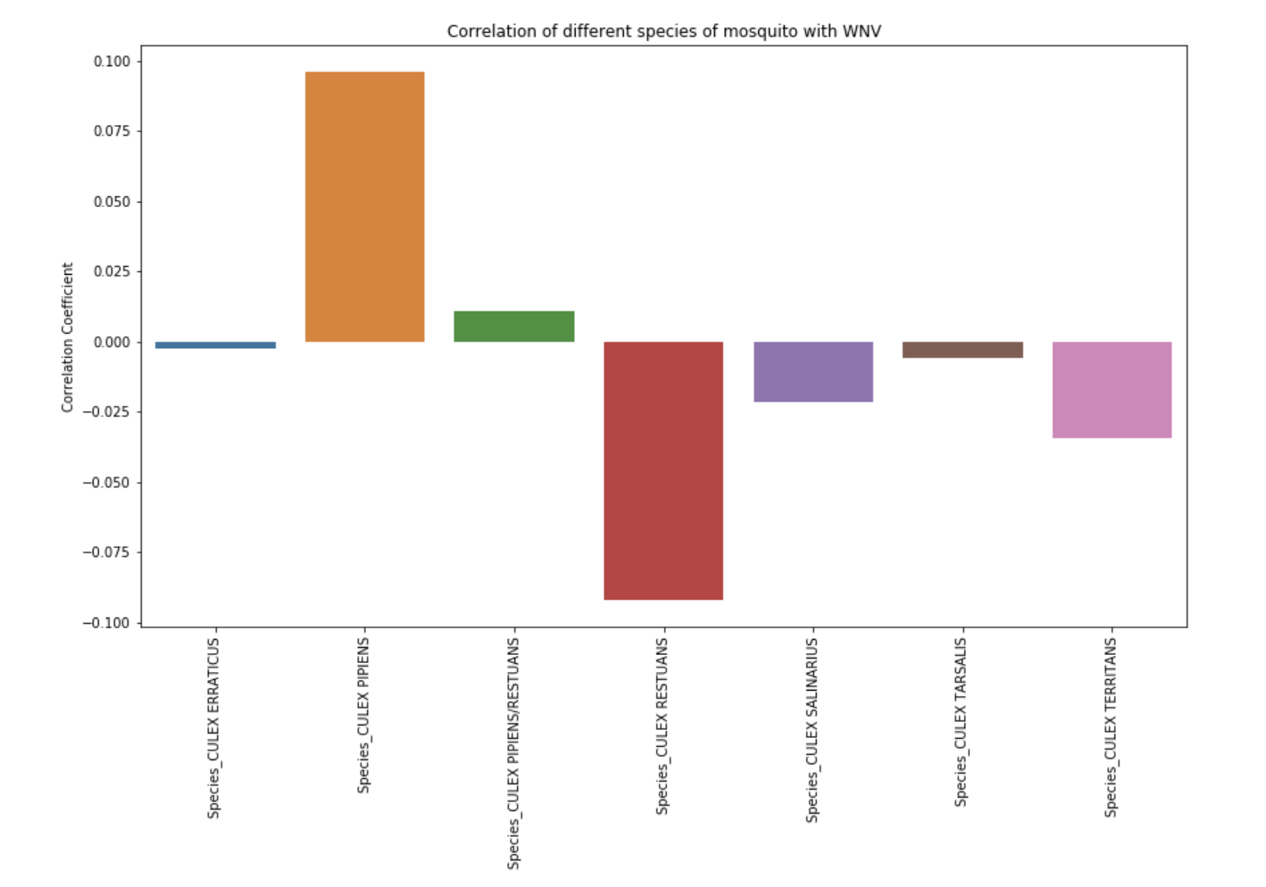
Notes:
Culex Pipiens - Highest positive correlation of species
Culex Restuans - Highest negative

Slide 8
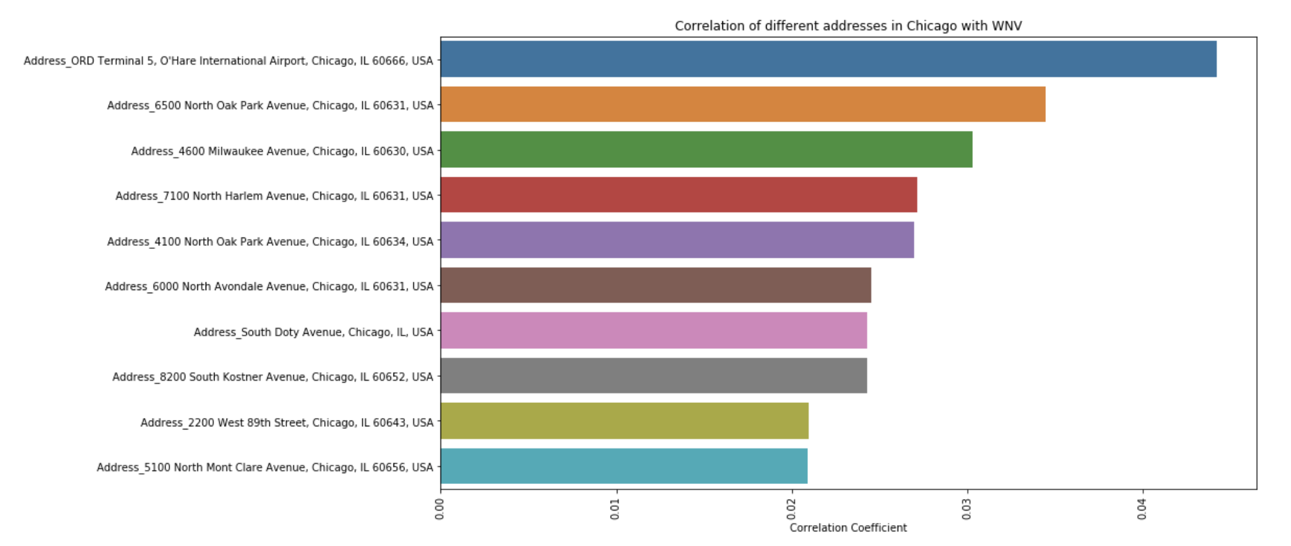

Slide 9
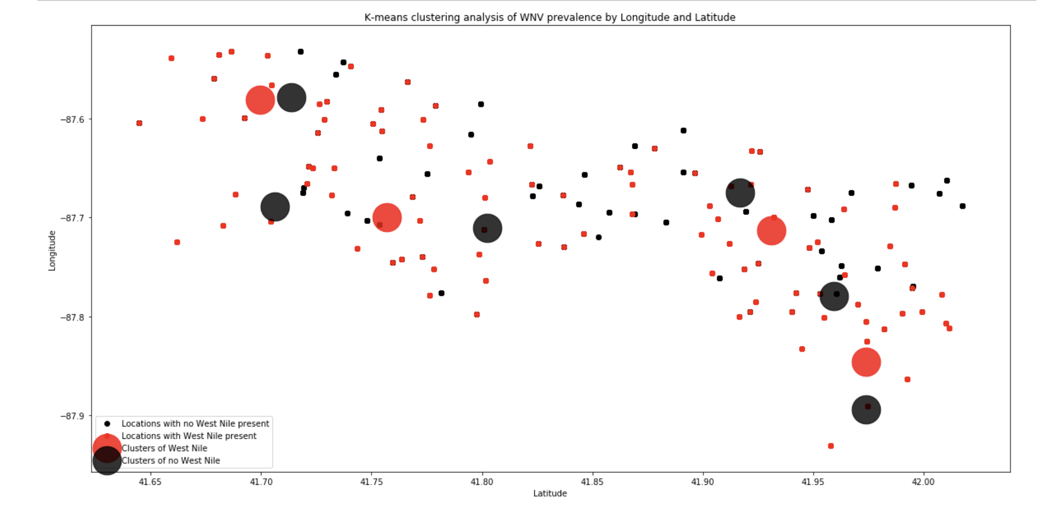

Slide 10
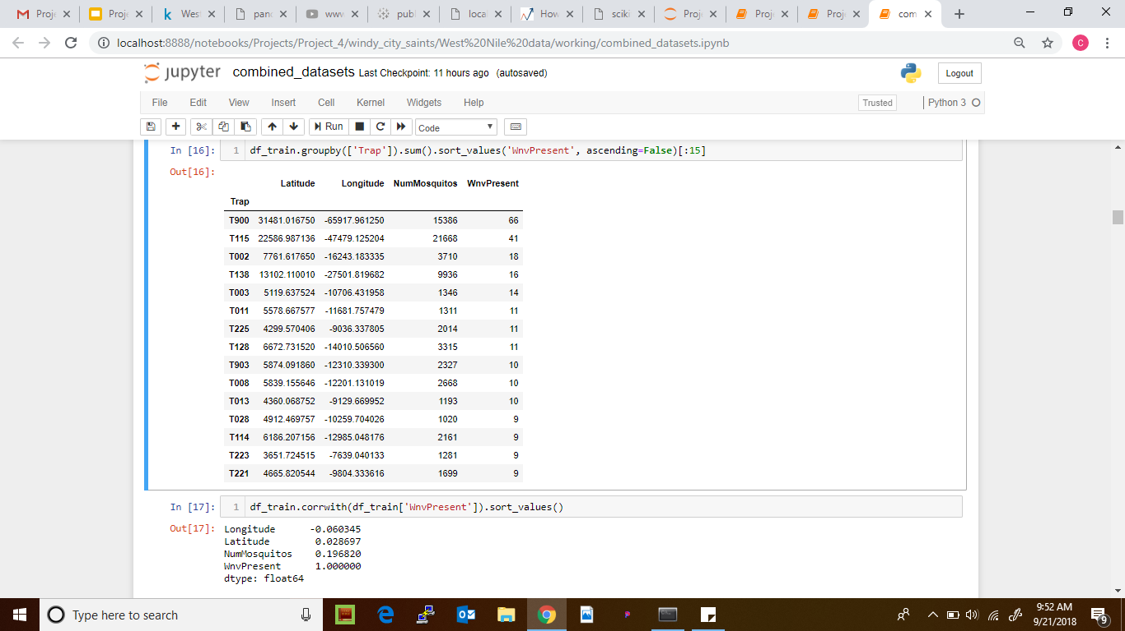
Train Data
This shows that increase in number of mosquitos in an area results in increase in presence of West Nile Virus

Slide 11
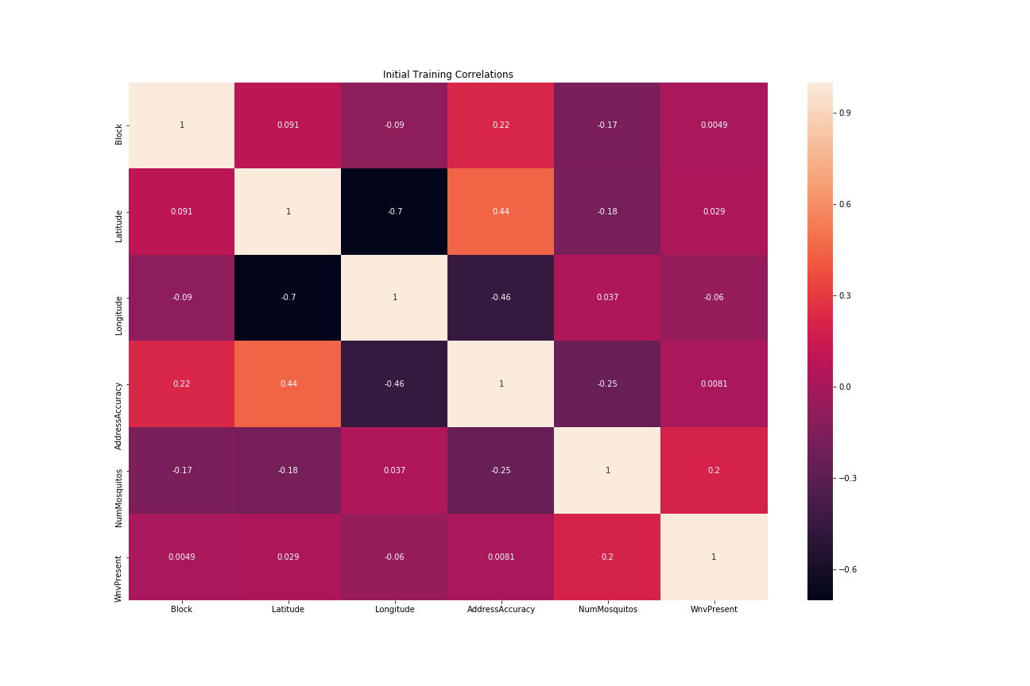

Slide 12
Base Model
Dropping Address details since they all point to logitude and lattitude.
Score with a logistic base model on the training data.
Training Score: 0.9484706180987434
Testing Score: 0.9467072706509326

Slide 13
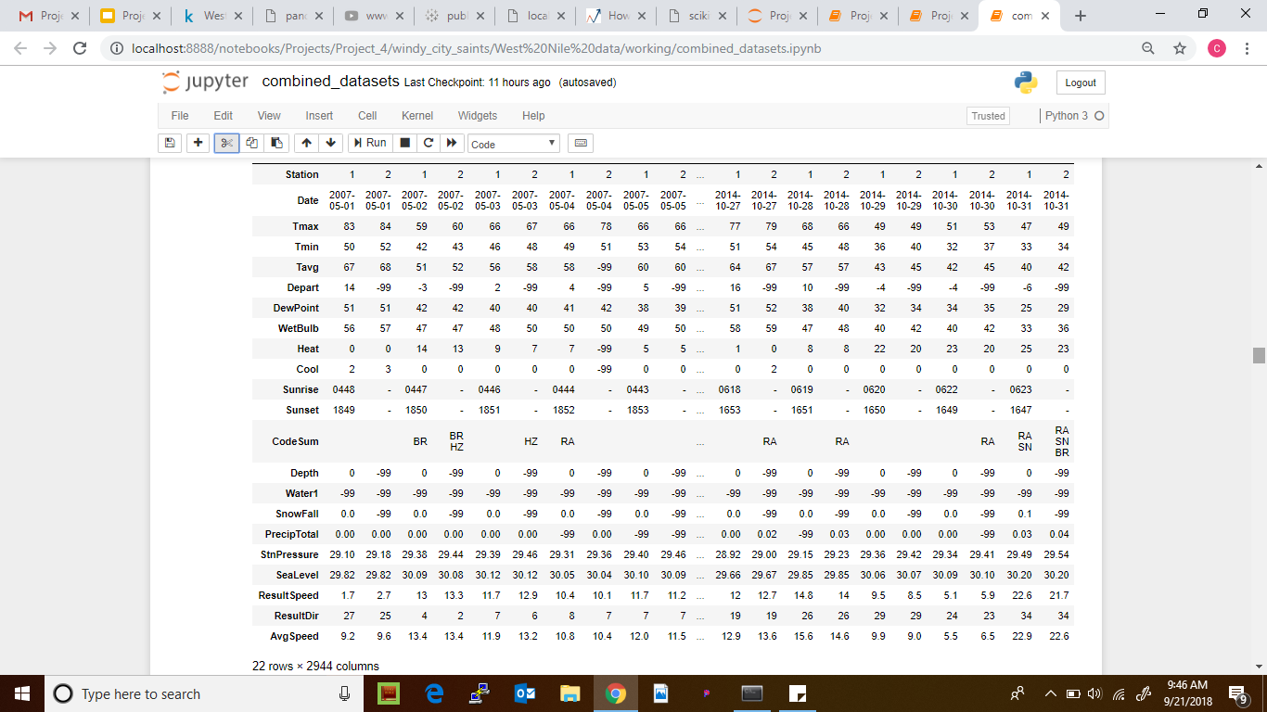
Weather Data

Slide 14
Data Cleaning
We are dropping the following columns:
'Sunrise', 'Sunset', 'CodeSum' - They provide no real values to our model.
'Water1'- since its the same for all
‘'Depart', 'Depth', 'SnowFall'- these values are consistently missing/Trace for one station

Slide 15
Cleaning Process Cont’d
Since our testing data does not include the number of mosquitos. We will be using our combined training and weather data to build a model that predicts the number of mosquitos which we will use on our test data. After we have corresponding values for our datasets then we will predict the Presence of West Nile Virus.

Slide 16
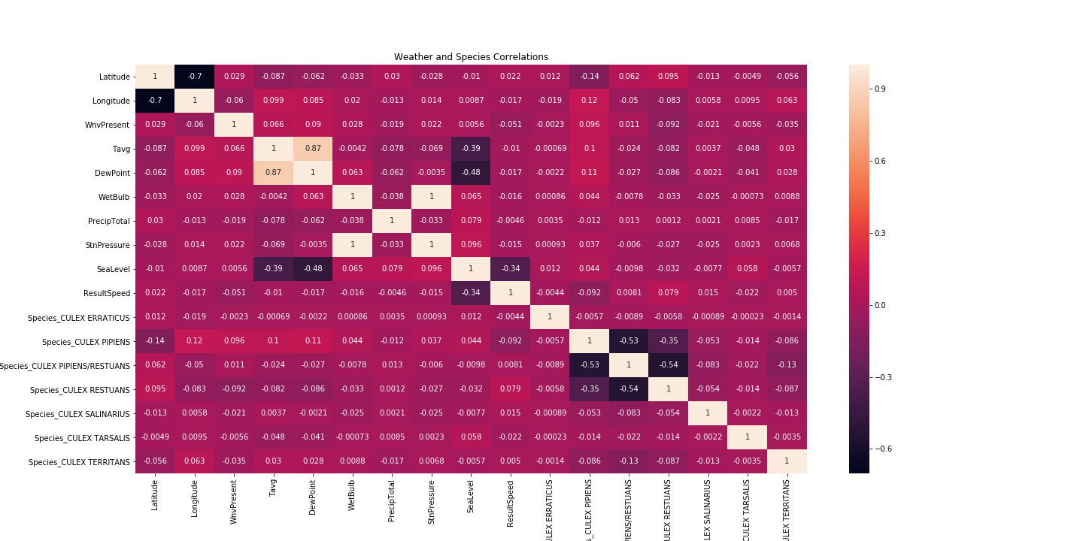

Slide 17
Modeling with combined data to predict number of mosquitos
After Dropping some variables
Score with a logistic model on the combined data.
Training Score: 0.2943080144679231
Testing Score: 0.2906910336950314
Score with a gradient boosting model on the training data.
Training Score: 0.4719208071578146
Testing Score: 0.2967827907862174

Slide 18
Modeling with kaggle data
Score with a logistic model on the kaggle data.
Training Score: 0.9475220508915541
Testing Score: 0.9476489624976204
Score with a gradient boosting model on the training data.
Training Score: 0.9515197664826448
Testing Score: 0.9514563106796117

Slide 19
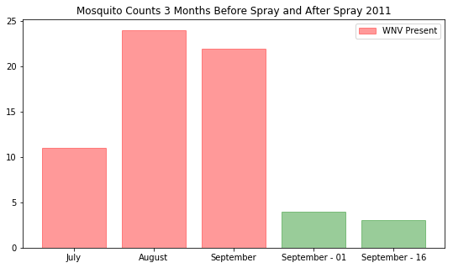

Slide 20
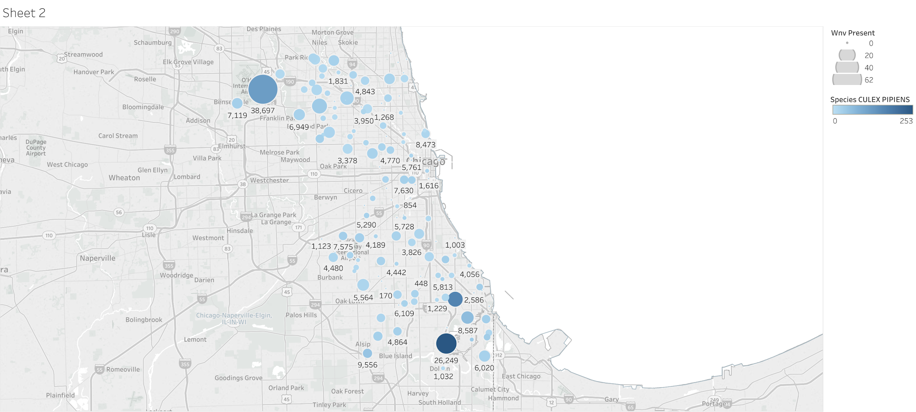
fadffdad
Concentration of West Nile Virus in Chicago, with dew point and Species Pipiens

Slide 21
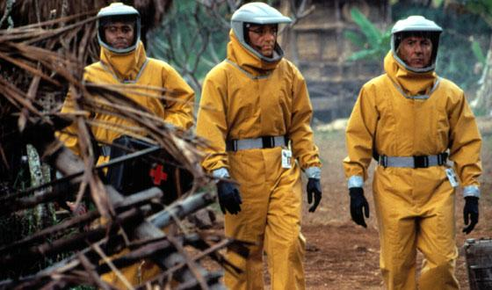
RECOMMENDATIONS
We wanted to include areas where there would be the perfect storm for West Nile infestation
Areas where birds could congregate and mosquitoes could feed.
Areas where if there is a decent amount of water for mosquitoes to breed.

Slide 22
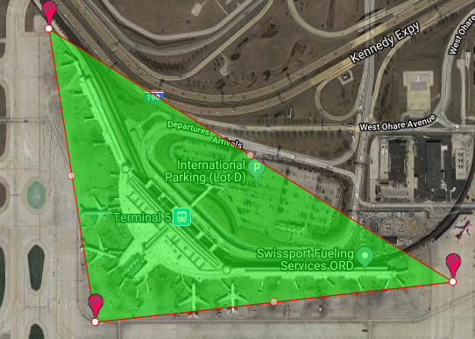
O’Hare International Airport--Terminal 5 is the largest International terminal in the U.S. (as of 2014) (41.974689, -87.890615
Size is 26,000 ft², which is approximately 0.60 acres of land
Size of recommended area - 54.04 acres

Slide 23
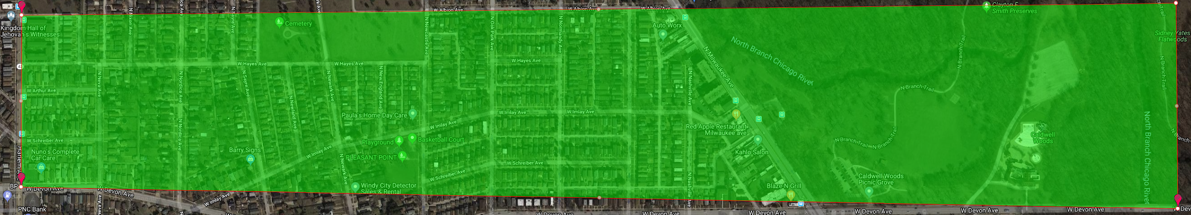
6500 North Oak Park Avenue--208.15 acres (41.999129, -87.795585)

Slide 24
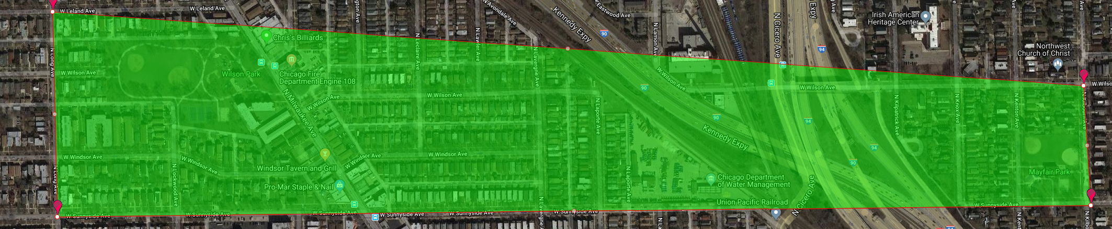
4600 North Milwaukee Avenue--119.46 acres (41.964242, -87.757639)

Slide 25
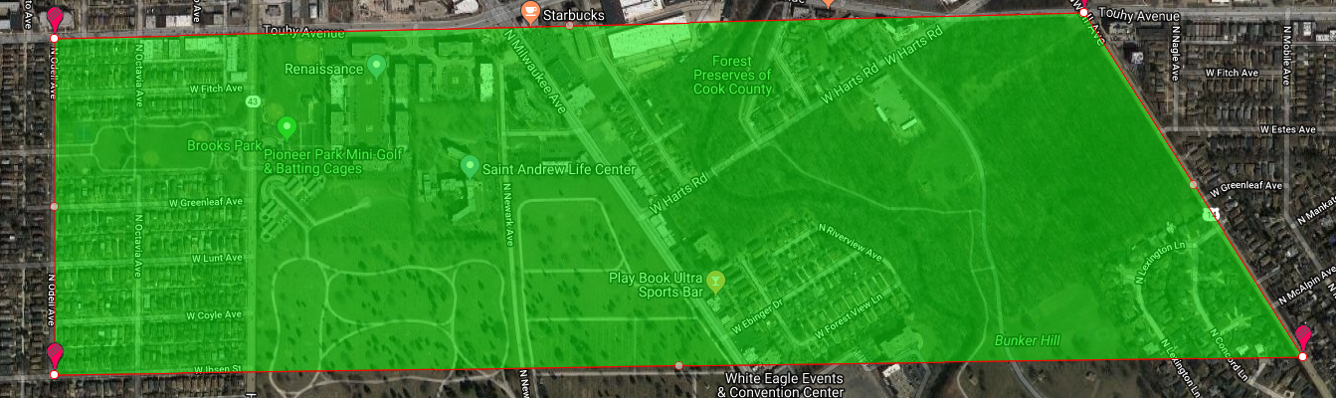
7100 North Harlem Avenue--305.61 acres (includes Forest Preserves of Cook County) (42.009876, -87.807277)

Slide 26
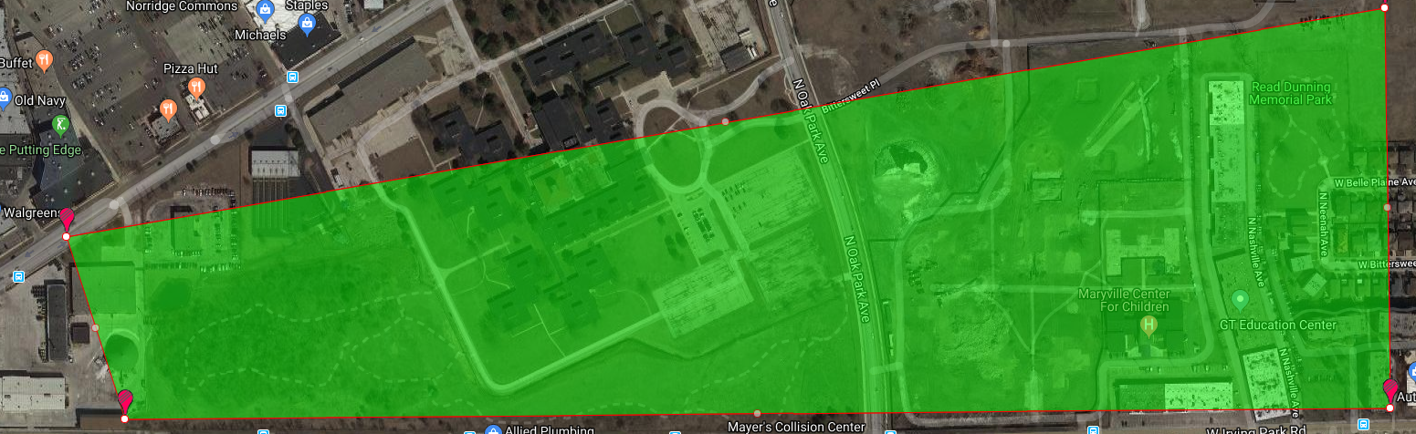
4100 North Oak Park Avenue--88.73 acres (41.95469, -87.800991)

Slide 27
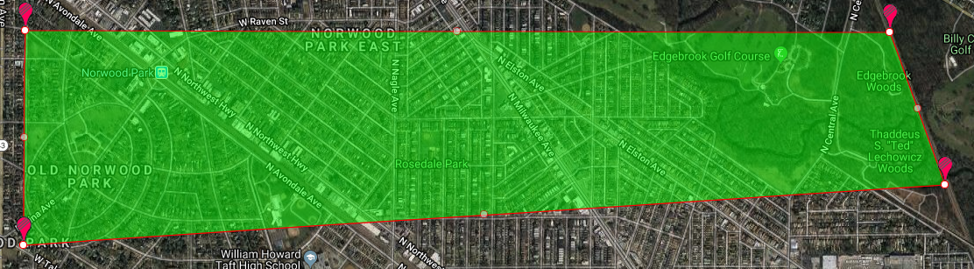
6000 North Avondale Avenue--666.71 acres (41.990284, -87.797127)

Slide 28
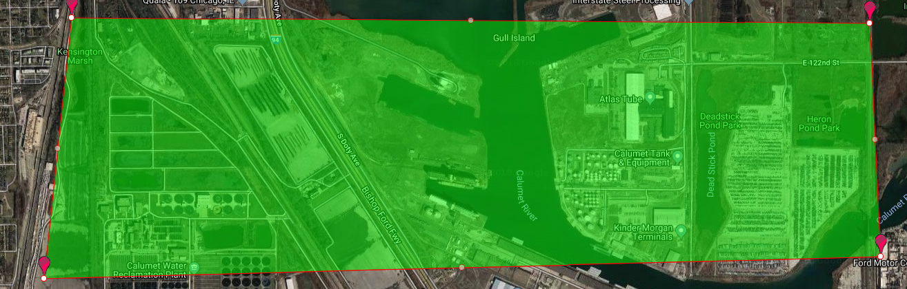
1200 South Doty Avenue--Close to Lake Calumet and Calumet Water Reclamation Plant - 1334.69 acres (41.673408, -87.599862)

Slide 29
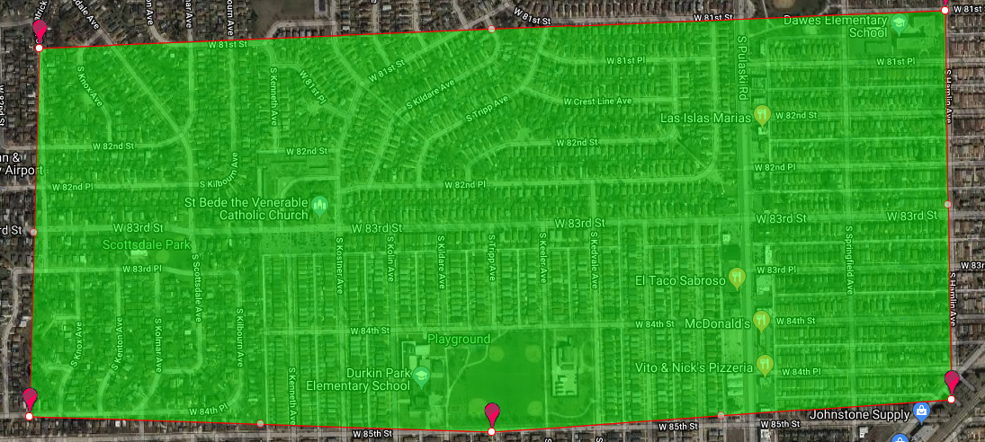
8200 South Kostner Avenue--345.81 acres (41.743402, -87.731435)

Slide 30
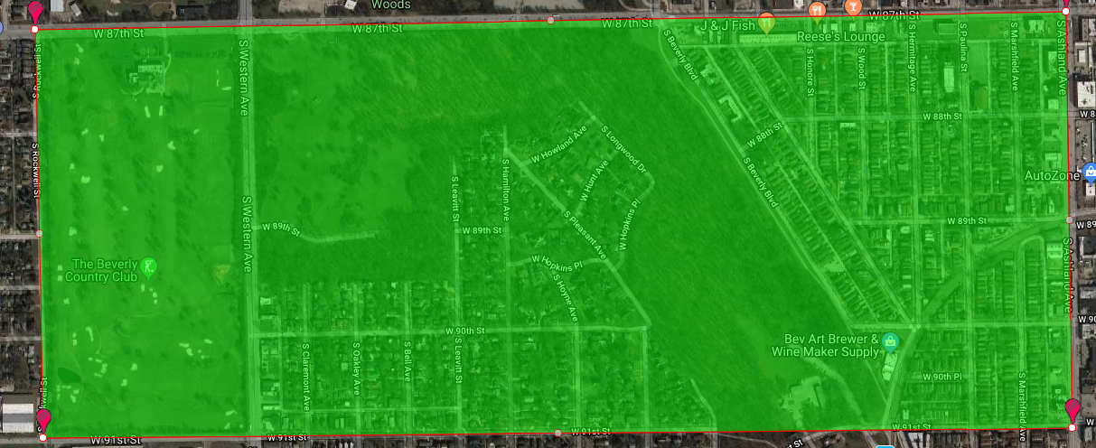
2200 West 89th Street--407.35 acres (41.731922, -87.677512)

Slide 31
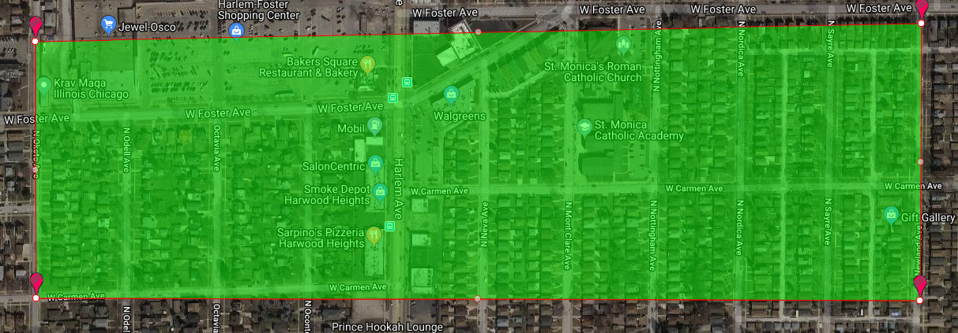
5100 North Mont Clare Avenue--73.75 acres (41.973845, -87.805059)

Slide 32

FINAL RECOMMENDATION
Total Acreage - 3604.29 acres
Proportion of Coverage - 2.41% of Chicago
Total Cost of Zenivex (as advertised) - Total Acreage * $0.67 per acre = $2414.87
30 gallon drum will provide 3840 fluid ounces
3604.29 * 1.5 fluid ounces per acre = 5406.44 fluid ounces needed = 42.24 gallons
1 30 gallon drum & 3 cases of 2*2.5 gallon = $13,522.50
Actual cost per gallon = $300.50
Actual cost per fluid ounce = $18.27 (according to the calculator on https://www.centralmosquitocontrol.com/resources/calculator)
Spray beginning of June, July, August, September, October (cost of Zenivex = $67,612.50

